Slide 1


Business Problem 5 – Super Market in Europe

Slide 2

Business Problem:
You have been hired by the Super Market in Europe as a Tableau Developer.
Your assignment is to deliver a visualization which will have details about the actual sales and the target sales by department. The data will be of different granularity and normal data joining will not help. With the functionality of data blending create a visualization which will show the above requirements.
Also create a view in the same visualization which will help business to understand how much the difference is from the actual sales and the target sales.
What we will learn today
Data Blending
Data Joining
Types of Joins
Inner Join
Left Outer Join
Right Outer Join
Full Outer Join
Difference between Data Blending and Data Joining
Where to use Data Blending and where to use Data Joining

Slide 3
How Data Joining works?

Slide 4
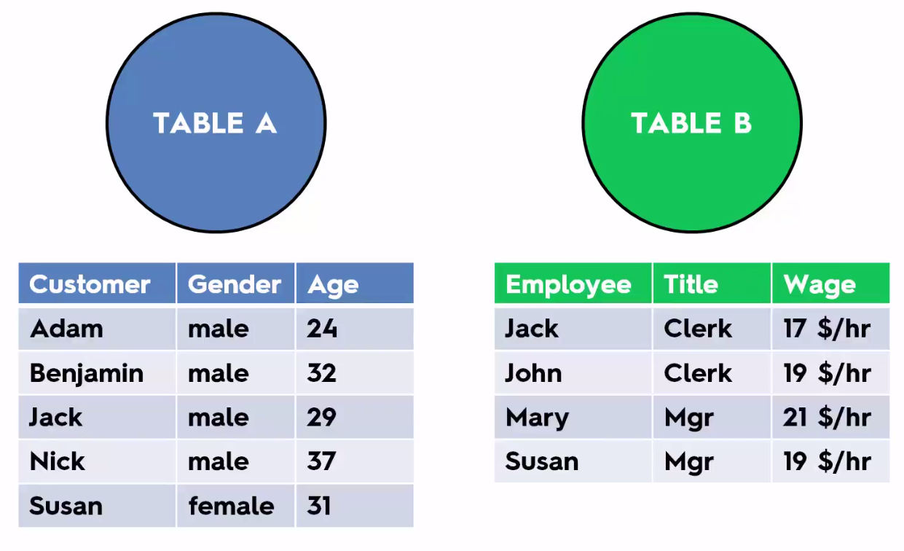

Slide 5
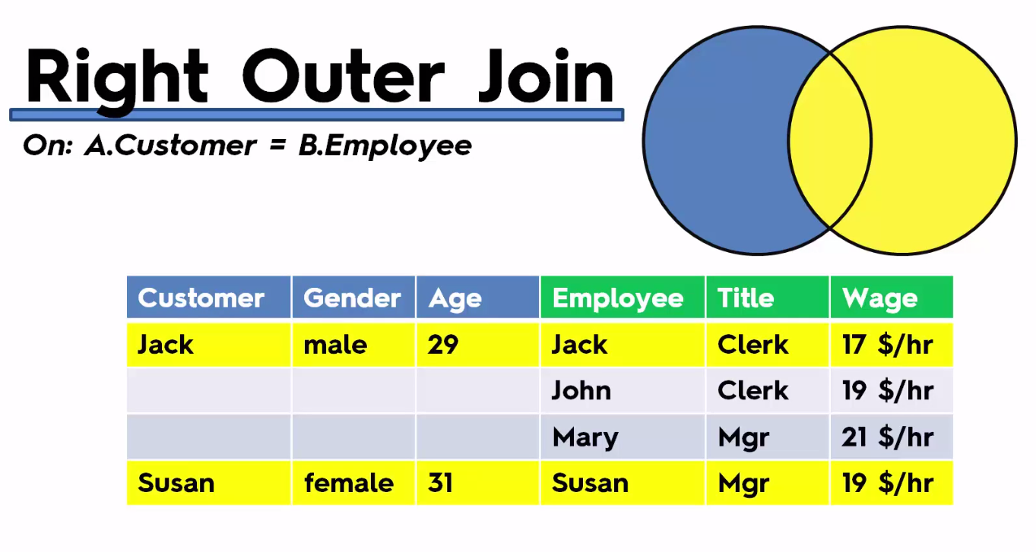
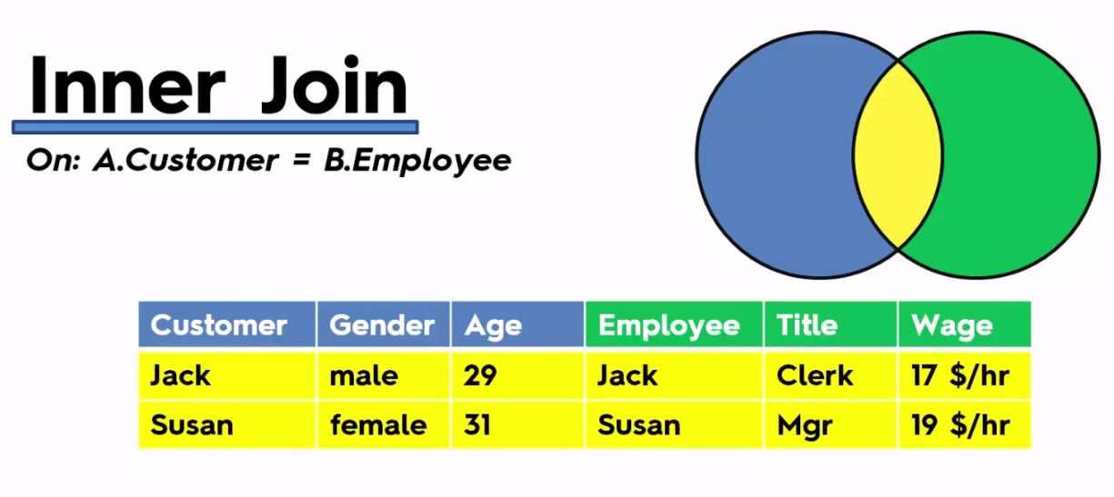
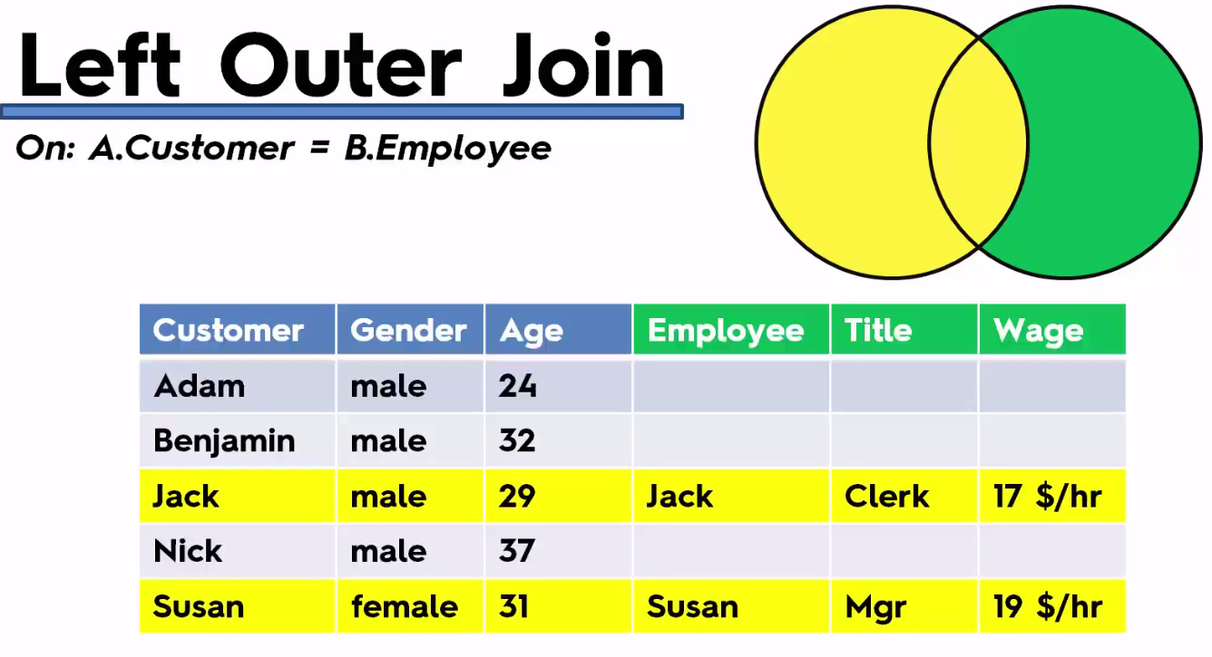
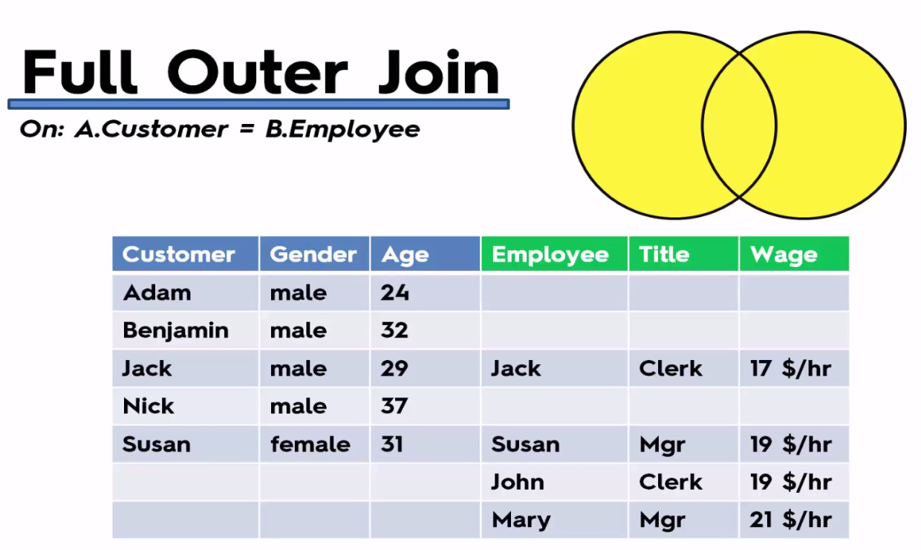

Slide 6
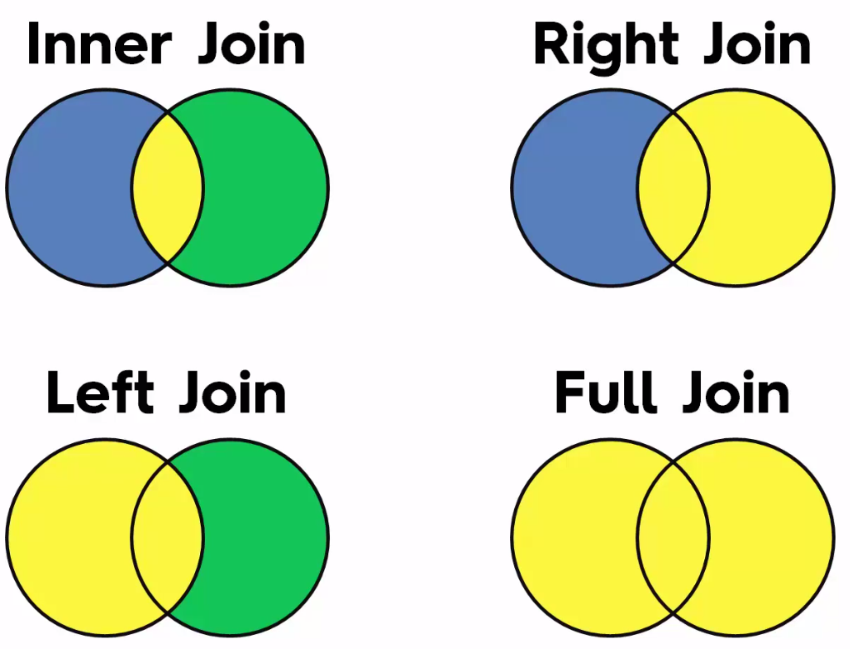

Slide 7
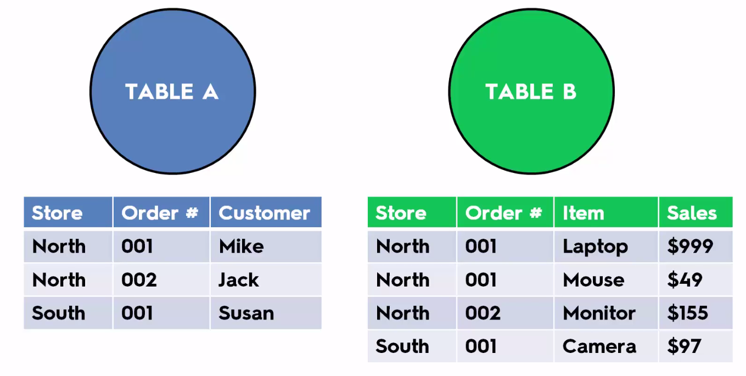
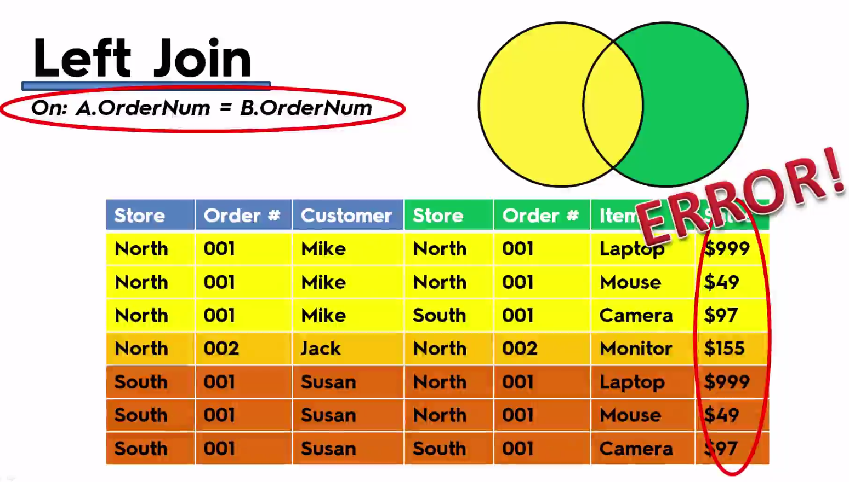
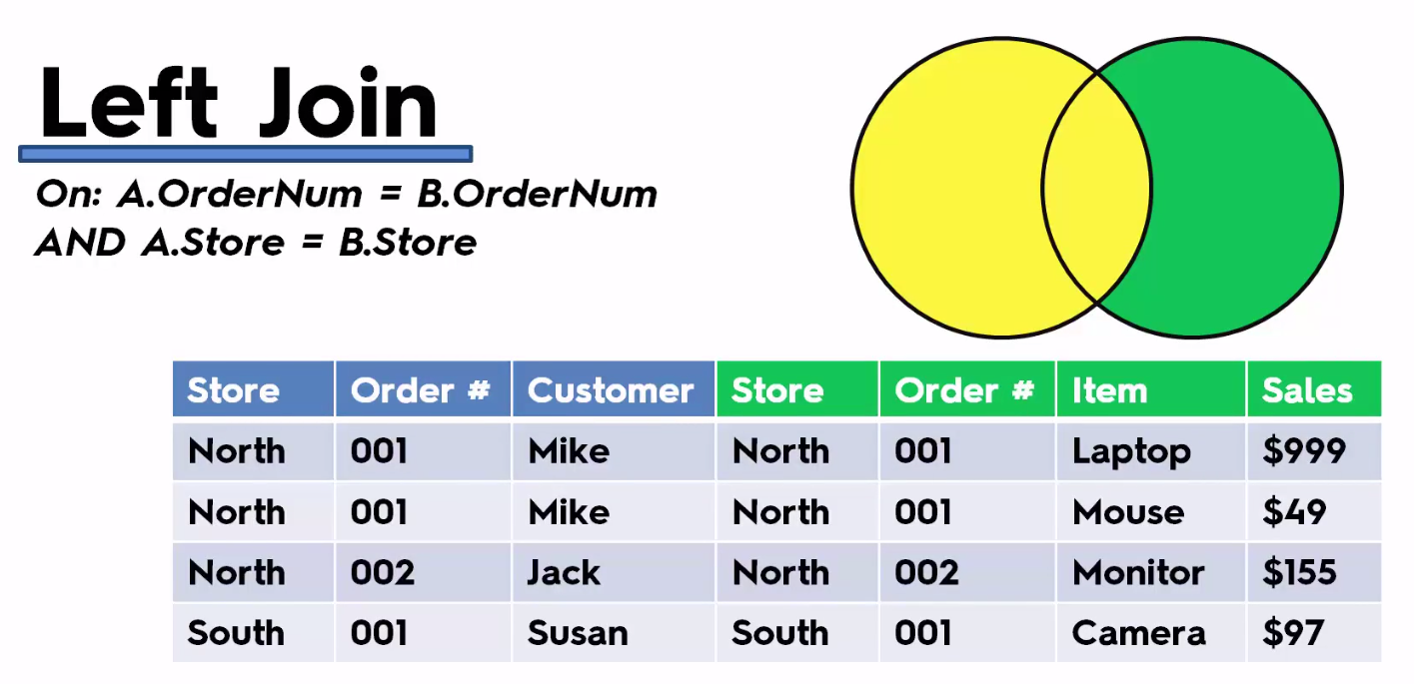

Slide 8
Where Data Blending require?

Slide 9
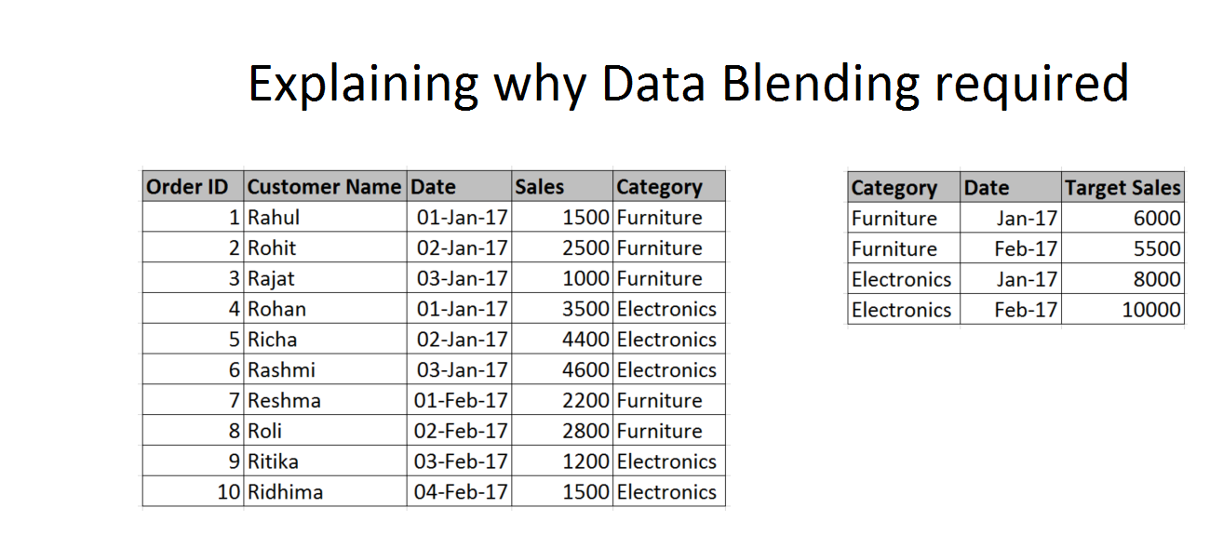
Scenario 1 – Different Granularity

Slide 10
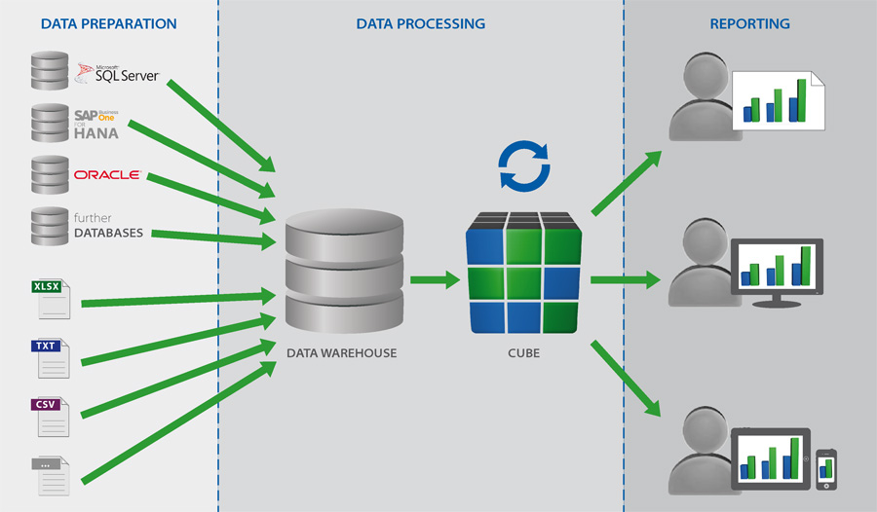
Scenario 2 – Disparate Data sources

Slide 11
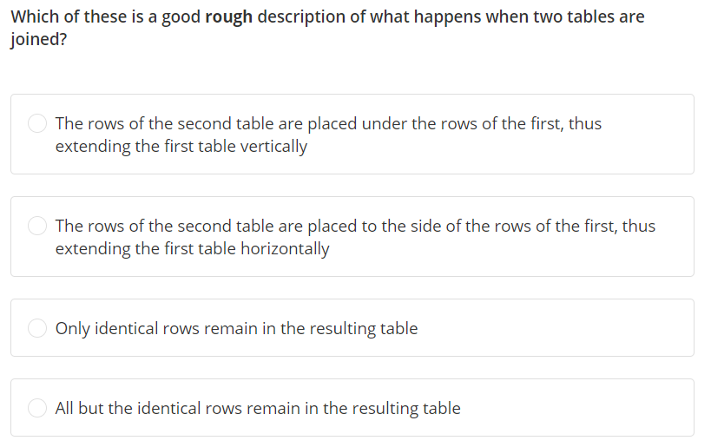

Slide 12
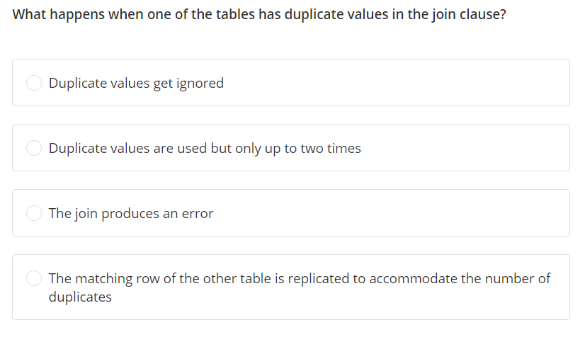

Slide 13
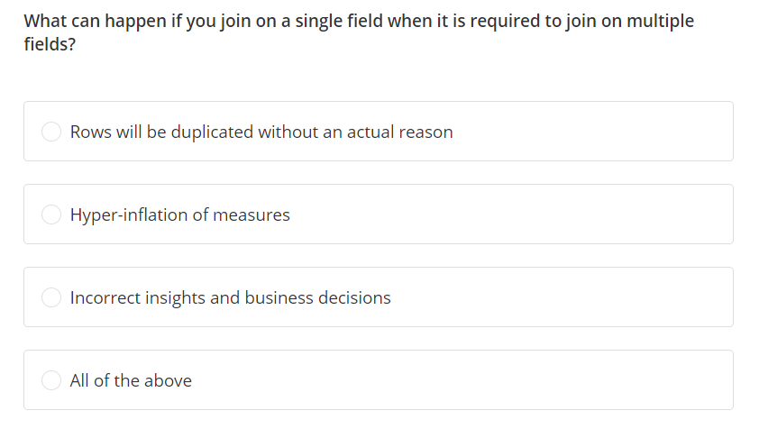

Slide 14
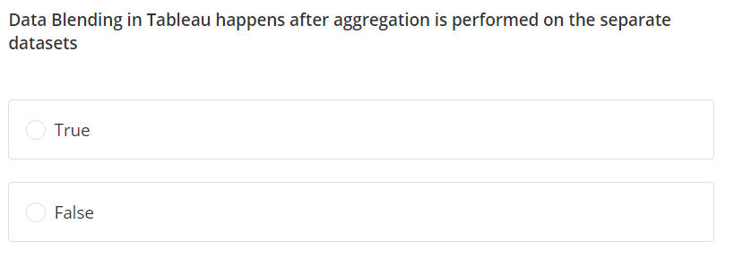

Slide 15
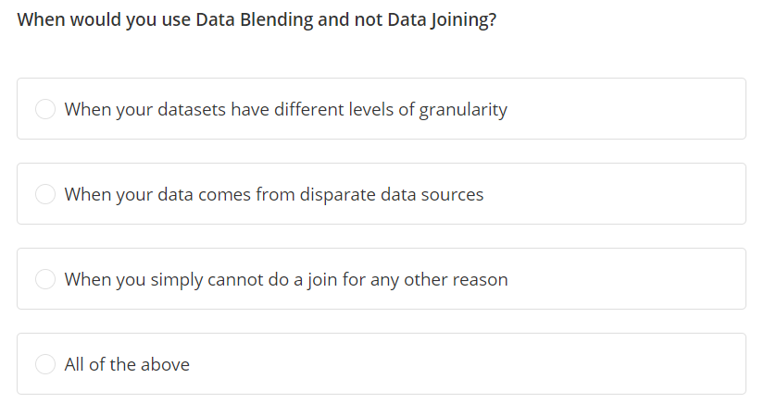

Slide 16
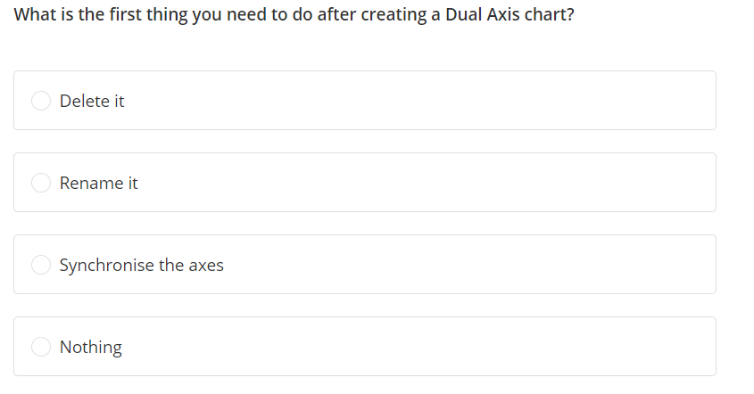

Slide 17
